Slide 1
Java: Collections
Jeremy J. Alkire
Brigham Young University – Idaho
CIT360: Object-Oriented Software Development II
Brother Tuckett
This presentation is modeled off of the information contained in the Java™ Tutorials on the Oracle website. Further information can be found at: https://docs.oracle.com/javase/tutorial/collections/

Slide 2
Introduction (Collections)
A collection – sometimes called a container – is simply an object that groups multiple elements into a single unit. Collections are used to store, retrieve, manipulate, and communicate aggregate data.
Typically they represent data items that form a natural group, such as a poker hand (a collection of cards), a mail folder (a collection of letters), or a telephone directory (a mapping of names to phone numbers).
Aggregate: A whole formed by combining several (typically disparate) elements.

Slide 3
Introduction (Collections Framework)
A collections framework is a unified architecture for representing and manipulating collections. All collections frameworks contain the following:
Interfaces: These are abstract data types that represent collections. Interfaces allow collections to be manipulated independently of the details of their representation. In object-oriented languages, interfaces generally form a hierarchy.
Implementations: These are the concrete implementations of the collection interfaces. In essence, they are reusable data structures.
Algorithms: These are the methods that perform useful computations, such as searching and sorting, on objects that implement collection interfaces. The algorithms are said to be polymorphic: that is, the same method can be used on many different implementations of the appropriate collection interface. In essence, algorithms are reusable functionality.

Slide 4
Introduction (Interfaces - Part 1)
The Java Collections Framework is broken down into various interfaces. The core collection interfaces in Java are:
Collection: This is the root of the collection hierarchy, and represents a group of objects known as its elements. All collections implement the Collection interface.
Set: A collection that cannot contain duplicate elements.
List: An ordered collection (sometimes called a sequence). Lists can contain duplicate elements. Users can specifically control where an element is in a list, and can access these elements by their integer index (position).
Queue: A collection used to hold multiple elements prior to processing. This interface has additional insertion, extraction, and inspection operations. Queues typically order elements in a FIFO (first-in, first-out) manner, but this isn’t always the case. Custom ordering priority can be set, and all queues must specify its ordering properties. The head of a queue is what would first by removed by a call to remove() or poll(). Elements are added at the tail first in a FIFO queue.
Deque: Essentially the same as a queue, but supports both FIFO and LIFO (last-in, first-out) sorting. All new elements can be inserted, retrieved, and removed at both ends.
Map: An object that maps keys to values. Maps cannot contain duplicate keys. Each key can map to only one value. A Map is not a true collection. (See figure 1 on the next page.)
Sorted Set: A sorted version of a set. This type of set maintains its elements in ascending order, and is used for naturally ordered sets, such as word lists and membership rolls.
Sorted Map: A sorted version of a map. This type of map maintains its mappings in ascending key order. Sorted maps are used for naturally ordered collections of key/value pairs, such as dictionaries and telephone directories.

Slide 5
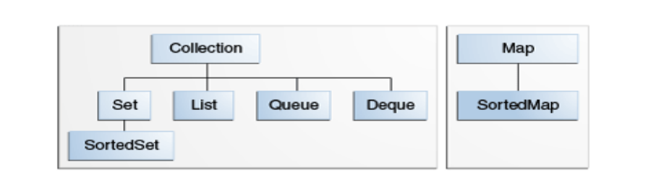
Introduction (Interfaces - Part 2)
The diagram below depicts the collection interface hierarchy. It shows the relationships between the core interfaces in the Java Collections Framework.
Figure 1

Slide 6
Introduction (Implementations – Part 1)
Implementations are the data objects used to store collections, which implement the interfaces in the Java Collections Framework. There are a few different categories of implementations:
General-purpose implementations are the most commonly used implementations, designed for everyday use. They are summarized in the table titled General-purpose-implementations.
Special-purpose implementations are designed for use in special situations and display nonstandard performance characteristics, usage restrictions, or behavior.
Concurrent implementations are designed to support high concurrency, typically at the expense of single-threaded performance. These implementations are part of the java.util.concurrent package.
Wrapper Implementations are used in combination with other types of implementations, often the general-purpose ones, to provide added or restricted functionality.
Convenience Implementations are mini-implementations, typically made available via static factory methods, that provide convenient, efficient alternatives to general-purpose implementations for special collections (for example, singleton sets).
Abstract implementations are skeletal implementations that facilitate the construction of custom implementations. (Similar conceptually to the concept of Abstract classes, in which standard Abstract or parent class methods can be overridden by it’s subclasses, in which the child class is able to write their own custom implementation of any given method inherited from the parent Abstract class.)

Slide 7
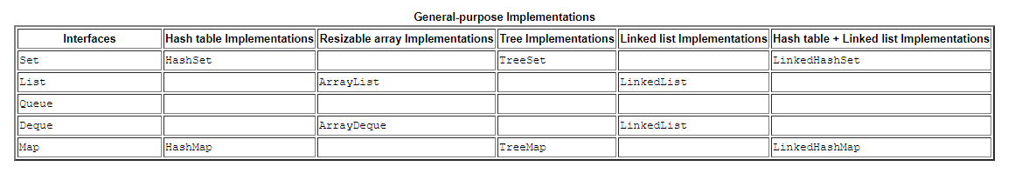
Introduction (Implementations – Part 2)
The general-purpose implementations are summarized in the following table:

Slide 8
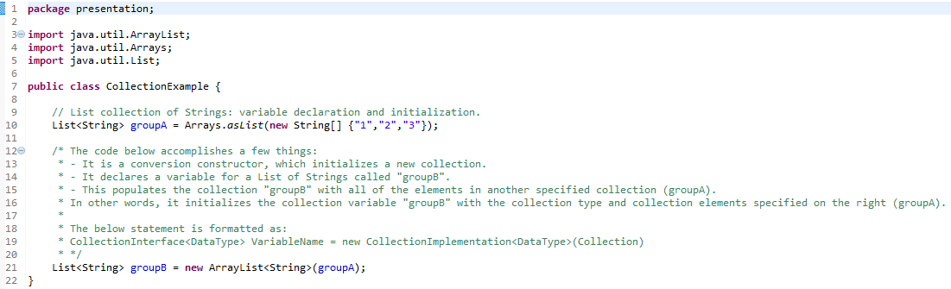
Interfaces (Collection – Part 1)
A collection represents a group of objects known as its elements. The Collection interface is used to pass around collections of objects where maximum generality is desired. By convention, all general-purpose collection implementations have a constructor that takes a Collection argument. This constructor, known as the conversion constructor, initializes the new collection to contain all of the elements in the specified collection, whatever the given collection’s sub-interface or implementation type. In other words, it allows you to convert the collection’s type.
Suppose for example you have a list collection of strings, called GroupA. The below segment of code would create a new ArrayList (an implementation of the List interface), initially containing all elements in GroupA:

Slide 9
Interfaces (Collection – Part 2)
The collection interface contains methods that perform basic operations, such as:
int size()
boolean isEmpty()
boolean contains(Object element)
boolean add(E element)
boolean remove(Object element)
Iterator<E> iterator()
It also contains methods that operate on entire collections, such as:
boolean containsAll(Collections<?> c)
boolean addAll(Collection<? Extends E> c)
boolean removeAll(Collection<?>)
boolean retainAll(Collection<?> c)
void clear()

Slide 10
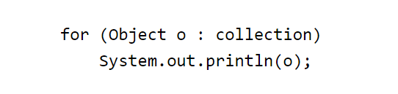

Traversing a Collection
There are three ways to traverse collections: (1) using aggregate operations (2) with the for-each construct and (3) by using Iterators.
Examples of aggregate operations, for each statements, and Iterators can be seen at:
https://docs.oracle.com/javase/tutorial/collections/interfaces/collection.html
https://docs.oracle.com/javase/8/docs/technotes/guides/language/foreach.html
A for-each construct allows you to traverse a collection or array using a for loop, such as in the image below:
The : symbol (colon) is read as “in”. Meaning the above example would be read as “for each object in collection, print the object o.” An example of a nested for-each statement (iterating through two collections) is below:

Slide 11
Collection Interface (Bulk Operations)
Bulk operations perform an operation on an entire Collection. You could implement these shorthand operations using the basic operations, though in most cases such implementations would be less efficient. The following are the bulk operations:
containsAll: returns true if the target Collection contains all of the elements in the specified Collection.
addAll: adds all of the elements in the specified Collection to the target Collection.
removeAll: removes from the target Collection all of its elements that are also contained in the specified Collection.
retainAll: removes from the target Collection all of its elements that are also contained in the specified Collection.
clear: removes all elements from the Collection.
The addAll, removeAll, and retainAll methods all return true if the target Collection was modified in the process of executing the operation.
Below is an example of the power of bulk operations, in which the statement removes all instances of a specified element, e, from a Collection, c: c.removeAll(Collections.singleton(e));
c.removeAll(Collections.singleton(null));
The above statements use Collections.singleton, which is a static factory method that returns an immutable Set containing only the specified element. In this instance, e and null.

Slide 12
Collection Interface (Array Operations)
The toArray methods are provided as a bridge between collections and older APIs that expect arrays on input. The array operations allow the contents of a Collection to be translated into an array. The simple form with no arguments creates a new array of Object. The more complex form allows the caller to provide an array or to choose the runtime type of the output array.
For example, suppose that c is a Collection. The following snippet dumps the contents of c into a newly allocated array of Object whose length is identical to the number of elements in c.
Object[] a = c.toArray();
Suppose that c is known to contain only strings (perhaps because c is of type Collection<String>). The following snippet dumps the contents of c into a newly allocated array of String whose length is identical to the number of elements in c.
String[] a = c.toArray(new String[0]);

Slide 13
Interfaces (List)
A List is an ordered Collection (sometimes called a sequence). Lists may contain duplicate elements. In addition to the operations inherited from Collection, the List interface includes operations for the following:
Positional access — manipulates elements based on their numerical position in the list. This includes methods such as get, set, add, addAll, and remove.
Search — searches for a specified object in the list and returns its numerical position. Search methods include indexOf and lastIndexOf.
Iteration — extends Iterator semantics to take advantage of the list's sequential nature. The listIterator methods provide this behavior.
Range-view — The sublist method performs arbitrary range operations on the list.
The Java platform contains two general-purpose List implementations. ArrayList, which is usually the better-performing implementation, and LinkedList which offers better performance under certain circumstances.
Further information (including examples of Collection operations, positional access and search operations, and Iterators) can be found at:
https://docs.oracle.com/javase/tutorial/collections/interfaces/list.html

Slide 14
Interfaces (Set)
A Set is a Collection that cannot contain duplicate elements. It models the mathematical set abstraction. The Set interface contains only methods inherited from Collection and adds the restriction that duplicate elements are prohibited. Set also adds a stronger contract on the behavior of the equals and hashCode operations, allowing Set instances to be compared meaningfully even if their implementation types differ. Two Set instances are equal if they contain the same elements.
The Java platform contains three general-purpose Set implementations: HashSet, TreeSet, and LinkedHashSet. HashSet, which stores its elements in a hash table, is the best-performing implementation; however it makes no guarantees concerning the order of iteration. TreeSet, which stores its elements in a red-black tree, orders its elements based on their values; it is substantially slower than HashSet. LinkedHashSet, which is implemented as a hash table with a linked list running through it, orders its elements based on the order in which they were inserted into the set (insertion-order). LinkedHashSet spares its clients from the unspecified, generally chaotic ordering provided by HashSet at a cost that is only slightly higher.
Further information (including examples and a list of basic Set operations) can be found at:
https://docs.oracle.com/javase/tutorial/collections/interfaces/set.html

Slide 15
Interfaces (Map)
A Map is an object that maps keys to values. A map cannot contain duplicate keys: Each key can map to at most one value. It models the mathematical function abstraction. The Map interface includes methods for basic operations (such as put, get, remove, containsKey, containsValue, size, and empty), bulk operations (such as putAll and clear), and collection views (such as keySet, entrySet, and values).
The Java platform contains three general-purpose Map implementations: HashMap, TreeMap, and LinkedHashMap. Their behavior and performance are precisely analogous to HashSet, TreeSet, and LinkedHashSet, as described in The Set Interface section.
Further information (including examples, a list of basic map interface operations, map interface bulk operations, and Collection view methods) can be found at:
https://docs.oracle.com/javase/tutorial/collections/interfaces/map.html

Slide 16
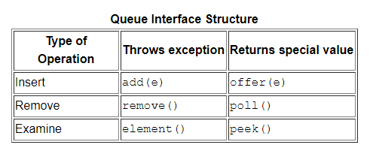
Interfaces (Queue – Part 1)
A Queue is a collection for holding elements prior to processing. Besides basic Collection operations, queues provide additional insertion, removal, and inspection operations. The Queue interface follows.
public interface Queue<E> extends Collection<E> {
E element();
boolean offer(E e);
E peek();
E poll();
E remove();
}
Each Queue method exists in two forms: (1) one throws an exception if the operation fails, and (2) the other returns a special value if the operation fails (either null or false, depending on the operation). The regular structure of the interface is illustrated in the following table.

Slide 17
Interfaces (Queue – Part 2)
Queues typically, but not necessarily, order elements in a FIFO (first-in-first-out) manner. Among the exceptions are priority queues, which order elements according to their values — see the Object Ordering section for details). Whatever ordering is used, the head of the queue is the element that would be removed by a call to remove or poll. In a FIFO queue, all new elements are inserted at the tail of the queue. Other kinds of queues may use different placement rules. Every Queue implementation must specify its ordering properties.
It is possible for a Queue implementation to restrict the number of elements that it holds; such queues are known as bounded. Some Queue implementations in java.util.concurrent are bounded, but the implementations in java.util are not.
The add method, which Queue inherits from Collection, inserts an element unless it would violate the queue's capacity restrictions, in which case it throws IllegalStateException. The offer method, which is intended solely for use on bounded queues, differs from add only in that it indicates failure to insert an element by returning false.
The remove and poll methods both remove and return the head of the queue. Exactly which element gets removed is a function of the queue's ordering policy. The remove and poll methods differ in their behavior only when the queue is empty. Under these circumstances, remove throws NoSuchElementException, while poll returns null.
The element and peek methods return, but do not remove, the head of the queue. They differ from one another in precisely the same fashion as remove and poll: If the queue is empty, element throws NoSuchElementException, while peek returns null.
Queue implementations generally do not allow insertion of null elements. The LinkedList implementation, which was retrofitted to implement Queue, is an exception. For historical reasons, it permits null elements, but you should refrain from taking advantage of this, because null is used as a special return value by the poll and peek methods.
Queue implementations generally do not define element-based versions of the equals and hashCode methods but instead inherit the identity-based versions from Object.
The Queue interface does not define the blocking queue methods, which are common in concurrent programming. These methods, which wait for elements to appear or for space to become available, are defined in the interface java.util.concurrent.BlockingQueue, which extends Queue.

Slide 18
Implementations (TreeSet)
TreeSet provides an implementation of the Set interface that uses a tree for storage. Objects are stored in a sorted and ascending order.
Access and retrieval times are quite fast, which makes TreeSet an excellent choice when storing large amounts of sorted information that must be found quickly.
A list of constructors supported by the TreeSet class can be found below:
TreeSet() – This constructor constructs an empty tree set that will be sorted in an ascending order according to the natural order of its elements.
TreeSet(Collection c) – This constructor builds a tree set that contains the elements of the collection c.
TreeSet(Comparator comp) – This constructor constructs an empty tree set that will be sorted according to the given comparator.
TreeSet(SortedSet ss) – This constructor builds a TreeSet that contains the elements of the given SortedSet.
A list of methods additionally defined by the TreeSet class (aside from those it inherits from it’s parents) can be found at:
https://www.tutorialspoint.com/java/java_treeset_class.htm

Slide 19
Implementations (TreeMap)
The TreeMap class implements the Map interface by using a tree. A TreeMap provides an efficient means of storing key/value pairs in sorted order, and allows rapid retrieval.
You should note that, unlike a hash map, a tree map guarantees that its elements will be sorted in an ascending key order.
A list of constructors supported by the TreeMap class can be found below:
TreeMap() – This constructor constructs an empty tree map that will be sorted using the natural order of its keys.
TreeMap(Comparator comp) – This constructor constructs an empty tree-based map that will be sorted using the Comparator comp.
TreeMap (Map m) – This constructor initializes a tree map with the entries from m, which will be sorted using the natural order of the keys.
TreeMap(SortedMap sm) – This constructor initializes a tree map with the entries from the SortedMap sm, which will be sorted in the same order as sm.
Additional documentation on TreeMap, alongside it’s additional methods (aside from those inherited from its parent classes) can be found at:
https://www.tutorialspoint.com/java/java_treemap_class.htm

Slide 20
References
https://docs.oracle.com/javase/tutorial/collections/
https://www.ntu.edu.sg/home/ehchua/programming/java/J5c_Collection.html
http://tutorialspoint.com/java/java_collections.htm
https://beginnersbook.com/java-collections-tutorials/#6

